Slide 1
USE OF ICR TECHNOLOGY FOR
THE INDONESIA 2010 POPULATION CENSUS
BPS Statistics Indonesia
New York, February 2011

Slide 2
Background
Population census in Indonesia is held every ten year.
Indonesia has the fourth largest population and the largest archipelago.
History of data processing for population census
  1971 - OMR Technology, mainframe
  1980 – data entry, mainframe
  1990 – data entry, mainframe, distributed
  2000 – OCR technology, PC clusters
  2010 – ICR and mobile technology, PC clusters.

Slide 3

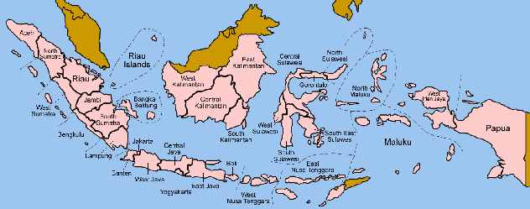
Data Processing Centers
Located in 33 Provincial Statistics Offices.
VPN

Slide 4

Flow of Documents in the Fields
DESA
KEC
FielDS
SP2010 L, KBC, RT, ART
ENUMERATOR
KORTIM
SP2010 L,
KBC, RT, ART
Doc Pool
Doc Pool
BPS
BPS
BPS
DISTRIC
BPS
Drop Off
Receiving & Handling
Queuing
PROVINCE
Expedition
Repack
Unpack &
Checking
Entry SP2010-L
Drop Off
Receiving & Handling
Queuing
Expedition/
Next Queuing
Unpack
Repack
Entry Coding

Slide 5
Flow of Processing Documents
FIELDS
Drop Off
Receiving & Handling
Registering
DROP-OFF SERVICE
STAGING
DOCUMENT STORAGE
DPC
Unpack &
Checking
FUMIGATION
REPACKING
SCANNING
Sorting
DOCUMENT
PREPARATION
VALIDATION
CORRECTION & COMPLETION
DOC PREP
Cutting

Slide 6






Flow of Data in DPC
BPS
DPC
INFORMATION TECHNOLOGY
Data Tabulasi
RELEASE
CAPTURE
SYSTEM
Status box
RECEPTION
SERVICE
Clean
Data
Staging
SUPPORT
APPS
BPS
Server
Lokasi box
DOCUMENT STORAGE
Data Staging
Image + data
Image + data
Data Validasi
Correction
&
Completion
Validasi
Scanning

Slide 7
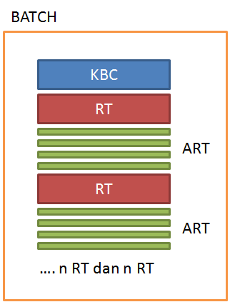
Batching System
Document batch
  1 SP 2010 KBC
  Consist of = n SP 2010 RT
  Each RT consist of = n SP 2010 ART

Slide 8
Solution Components
Guillotine
PCs
Server
Scanner
Software Data Capture
Training & troubleshooting
Template Development
Distribution, installation & implementation in each DPC (33 locations)

Slide 9
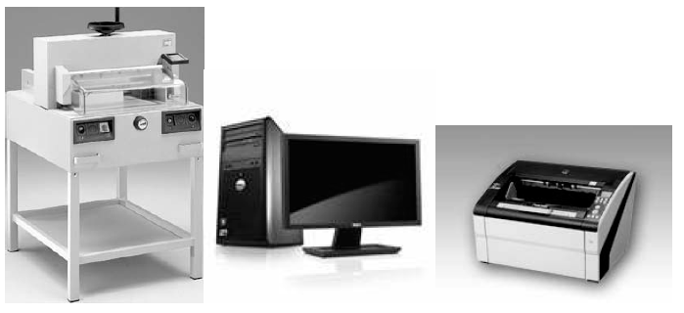
Guillotine, workstation, scanner

Slide 10


Kofax Implementation Overview
Scan
Recognition
Correction
Completion
Release

Slide 11






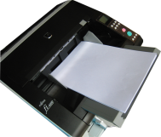


Capture Process Flow
Server Data Capture
Server Database
Classification
Recognition
PC Document
Review
PC & Scanner
PC Correction
PC QUALITY
CONTROL
PC Completion

Slide 12
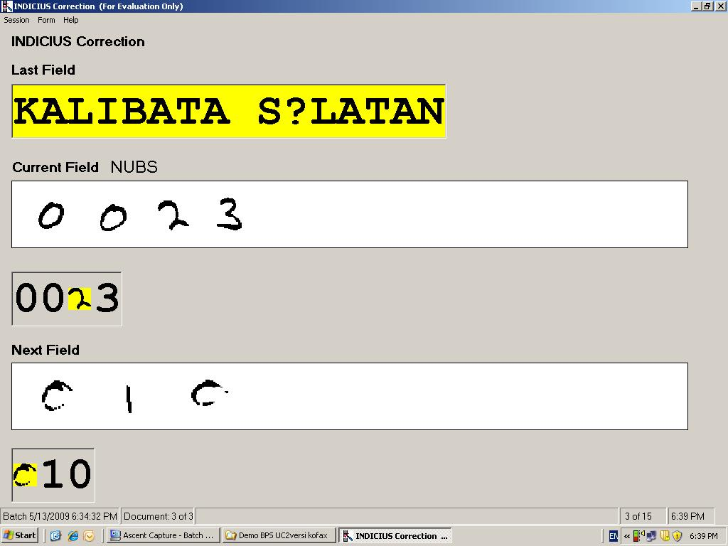
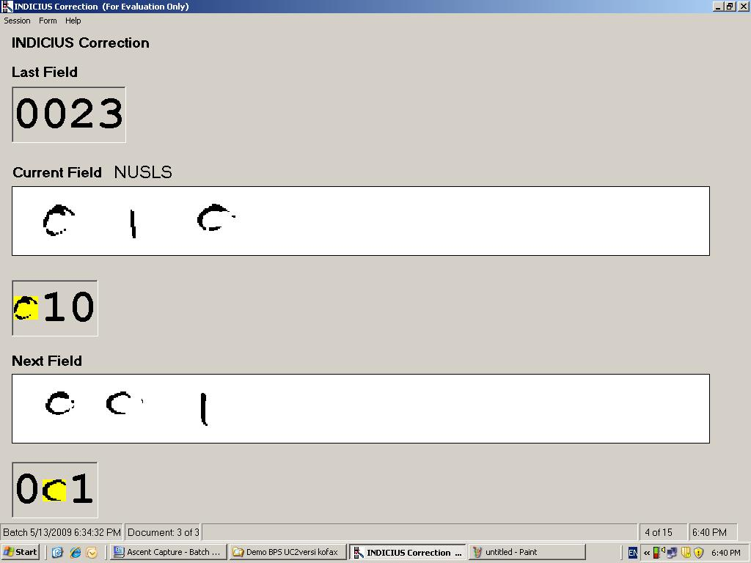
Kofax - Correction
Sample Screen:

Slide 13
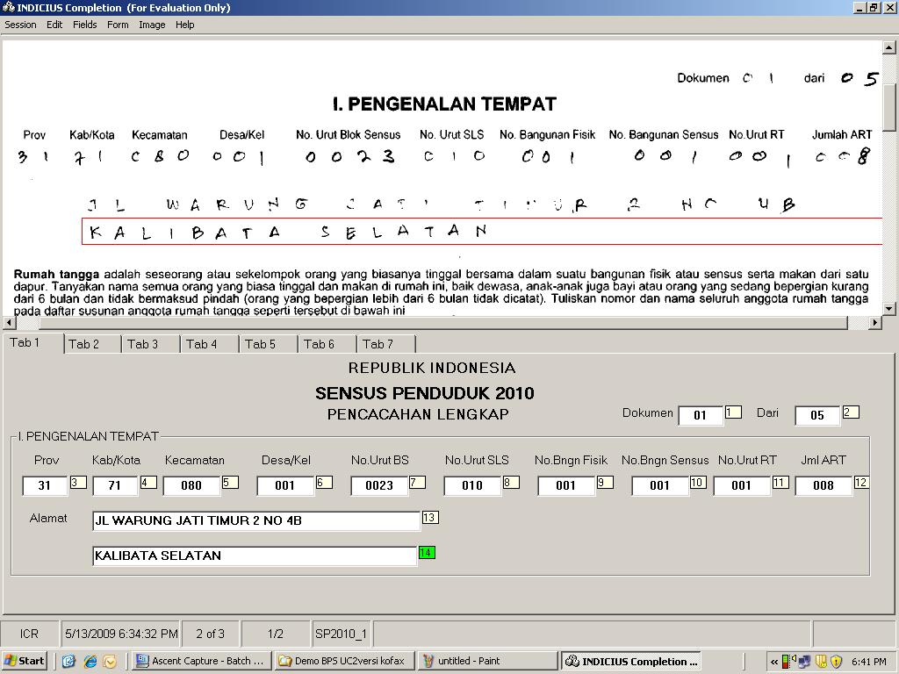
Kofax – Completion
Sample Screen
ENTRY PANEL IN TABULAR FORMAT TO CATEGORISED FIELD

Slide 14
Kofax – Completion
LOCATION ID CHECKING , DATA LOOKUP TO DATABASE

Slide 15
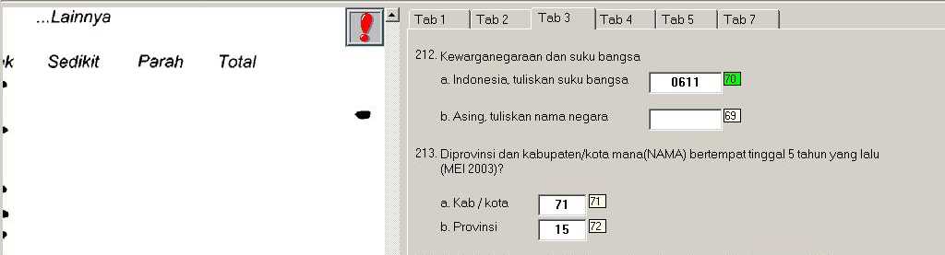
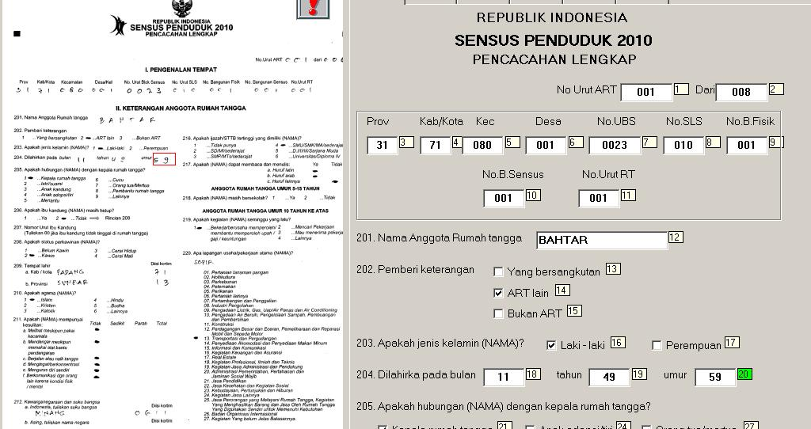
Kofax – Completion
Business Rules
VERIFICATION
CHILD NATIONALITY VS BIOLOGICAL FATHER &/ MOTHER
Business Rules
VERIFICATION
CHILD AGE W/ BIOLOGICAL MOTHER

Slide 16
Population of Indonesia based on the Census, May 2010
(preliminary figures, Released Aug 2010)
Male (000) | Female (000) | Male + Female (000)
119,508 | 118,048 | 237,556

Slide 17
Thank You

